Slide 1
Modelling and Representation
Week 1 Lecture 2

Slide 2
In the previous lecture
Model (ideas associated with Model)
  Abstraction
  Simplification
  Mapping
  Cost
  Size

Slide 3
Representation
How something is represented internally in a computer
  Sound : MP3, WAV, .RA etc.
  Images : JPG, GIF, PNG etc.
Why do we care?
  CS is all about manipulating data that represents something

Slide 4
Modelling and Representation
Is a photograph a model or a representation?
  Model.
  The jpg (or png, etc.) is the representation

Slide 5
Models
Models can be:
  Descriptive: a design or description of something that exists
  Prescriptive: provide the best solution to a problem

Slide 6
Descriptive Models
Examples of descriptive models:
  Maps
  Exact content of map depends on person’s interest
Example: Maps of Amsterdam

Slide 7
Descriptive Models
Example:
  How good were CS4111 students?
    Average: B3
    Average mark: 59.74
    Standard deviation 20.35
    Max 96.15, Min 11.25

Slide 8
Prescriptive Models
Prescriptive Models:
  To prescribe is to “lay down as a rule” (Collins Dictionary)
  Example from last lecture
    Min(T_i) where T_i=a_i + b_i + c_i
    Simple model only deals with time
    Add in stress involved in travelling
    Cost_i = T_i + Stress_i

Slide 9
Concepts in Modelling
Indirection
  “roundabout act, procedure, or means ” (http://www.yourdictionary.com)
Example: I order a steak in a restaurant.
Who is involved?
  Farmer
  Slaughterhouse
  Delivery/Butcher
  Chef
  Waiter

Slide 10
Indirection
We don’t grow our own food
  We buy it in shops
We don’t propel ourselves forward
  We pull levers and turn wheels
We don’t travel to every sporting event
  We read newspapers and watch TV
Indirection is a form of abstraction

Slide 11
Concepts in Modelling
Abstraction
  “formation of an idea, as of the qualities or properties of a thing, by mental separation from particular instances or material objects “ (http://www.yourdictionary.com)

Slide 12
Abstraction
We abstract over much of what we do
  Driving a car..do you know what happens under the bonnet when you turn the key in the ignition?
  Do I know the type of hardware or software required for the projector to operate correctly?
  Do you understand how the java code that you write in an editor becomes an executable program?

Slide 13
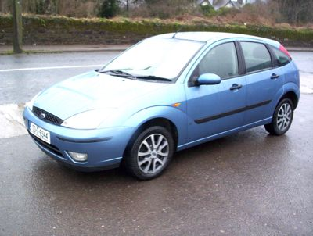
Modelling
Modelling involves abstraction
  Photographs
  Textual descriptions
Make Ford Model Focus
Engine 1.4 Litre Gearbox manual
Body Hatchback Price €14,000
Year 2003 Colour light blue
Mileage 30,000 Condition Doors 5 dr
Notes Central Locking, Electric Windows, Power Steering, ff alloys

Slide 14
Types of Models (Iconic)
1. Iconic Models bear some resemblance to the original object:
  Can be represented in 2 or 3 dimensions
  2 dimensions
    Pictures
    Photographs
    Graphs and diagrams
  3 dimensions
    Statues
    Scale Models

Slide 15
Types of Models (Iconic)
A scale model can be a:
  Reduction
  Reproduction
  enlargement

Slide 16
Types of Models (Analogue)
  Analogue models involve representing the properties of the problem by distinct features of the model
  Properties and materials in real life represented by different properties and materials in the model
  Analogue: something that is similar in some respects
  e.g. an ordnance survey map which uses contours or colour coding to represent different altitudes

Slide 17
Types of Models (Symbolic)
Symbolic models have been learned
  Symbols can be
    Mathematical
    Logical
    Ad-hoc
  Cannot be worked out without prior knowledge

Slide 18
Types of Models (Symbolic)
Symbolic models used when the reality is
  Too complex or too abstract to be portrayed by an iconic or analogic model
  Mathematical models
  Optimization models
  Statistical models
  e.g. Chemical formulae, traffic signs

Slide 19
Models
A photo
  Suppose we travel to Toronto and look at a house. Later I show you a picture of the house. You recognise it because the picture resembles the house
  What sort of model is the photo?

Slide 20
Models
An address
  We travel to Toronto and look at a house. Later I show you the address of the house written down. It doesn’t make any sense to you. Unless I’ve already told you the address of the house this model is of no use to you.
  What sort of model is the address?

Slide 21
Static Models
Models which are built once and do not change
  Models of buildings or bridges
  E=mc²

Slide 22
Dynamic Models
A model which changes as the reality being modelled changes
  E.g. a speedometer
  The speedometer reacts to changes in our speed
  E.g. a thermometer
  As the temperature increases the mercury in a thermometer rises
  An analogic dynamic model

Slide 23
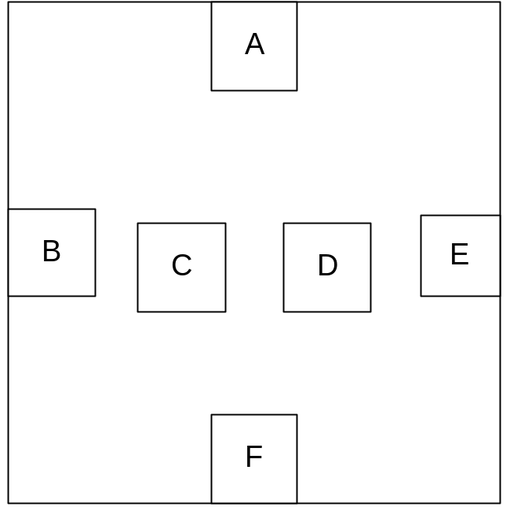
Models for problem solving 1
Consider the following model of an electronic board

Slide 24
Models for problem solving 1
The task is to join A-F, B-D and C-E by wires such that the wires do not intersect
  Possible?
  How to come up with the solution?

Slide 25
Models for problem solving 2
Consider the following:
3 houses are built at one side of the road and the connections for water, gas and electricity are at the other side of the road. If the pipes carrying the water, gas or electricity cross each other, a deeper excavation is required increasing the connection cost substantially……PTO

Slide 26
Models for problem solving 2
Is it possible to connect the three houses to the water, gas and electricity without requiring extra excavation?

Slide 27
Useful Links
Remember material on the web has not been peer-reviewed!
http://www.naaidt.org.uk/about/guidelines/modelict.html
http://www.problemistics.org/courseware/toolbook/modelling.html

Slide 28
Summary
Modelling versus Representation
Descriptive and Prescriptive models
Indirection and abstraction in modelling
Types of models
  Iconic, Analogue and Symbolic
  Dynamic and static
Models for problem solving

